Slide 1
Climate and Environmental Physics Experimental Climate and Environmental Physics Prof. H. Fischer (ice cores, paleoclimate, biogeochemical cycles) Prof. M. Leuenberger (environ. archives, atmosphere, stable isotopes) Dr. Roland Purtschert (hydrology, radiometric dating) Modeling of Climate and Environmental Physics Prof. Th. Stocker (ocean-/atmosphere dynamics) Prof. F. Joos (biogeochemical cycles) Prof. Ch. Raible (atmosphere dynamics)

Slide 2
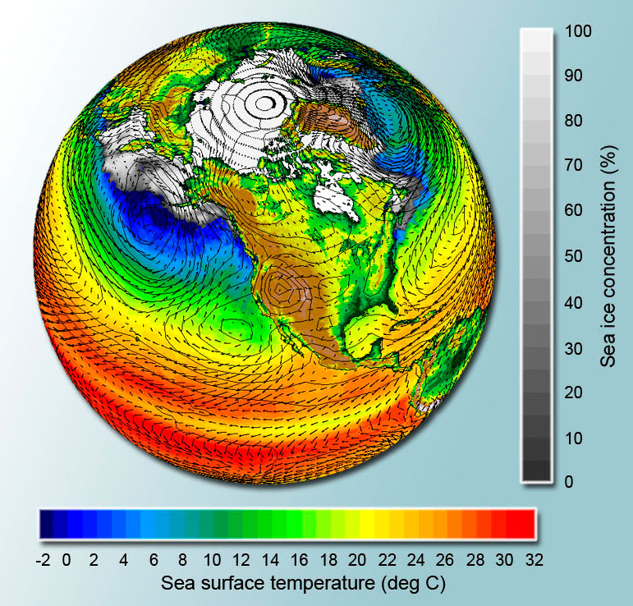
Components of the Earth climate system
Biosphere
Cryosphere
Atmosphere
Hydrosphere

Slide 3
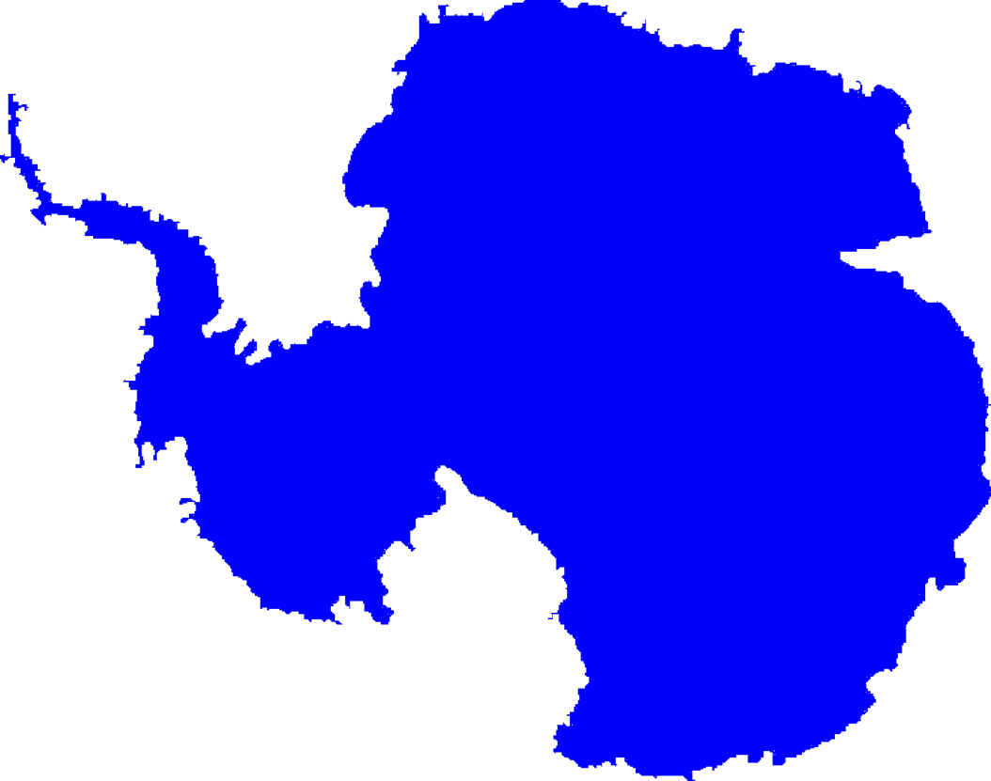
Ice cores from Greenland and Antarctica:
Climate and atmosphere over the last 130’000 - 800’000 Jahre
NEEM
EPICA DML
NGRIP
GRIP
EPICA Dome C
Ice cores, paleoclimate, biogeochemical cycles (contact: hfischer@climate.unibe.ch)
Notes:
transfer: bidirektional & zudem getrieben von single advektion events
loss sub cloud scavenging and exp loss
additional „spource“ (also marine): Oxidation of SO2
deposition: the NH4 & SO4 is found in the same manner silvente&legrand 93
25-32% SO2 gemittelt kommt aus dem Ozean (Korhonen 08)
18-42% SO4(p)

Slide 4
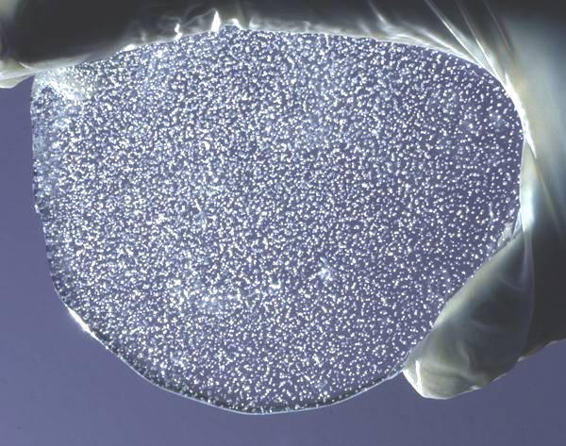
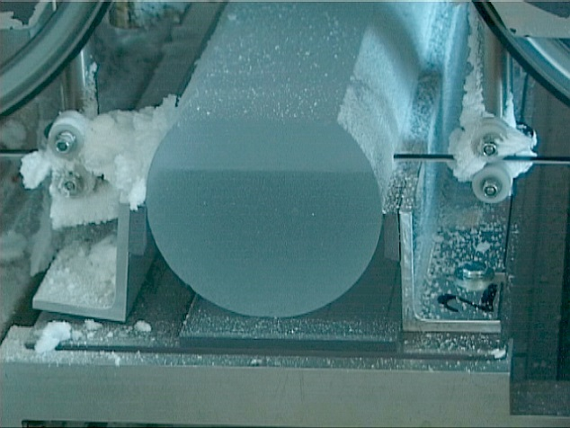
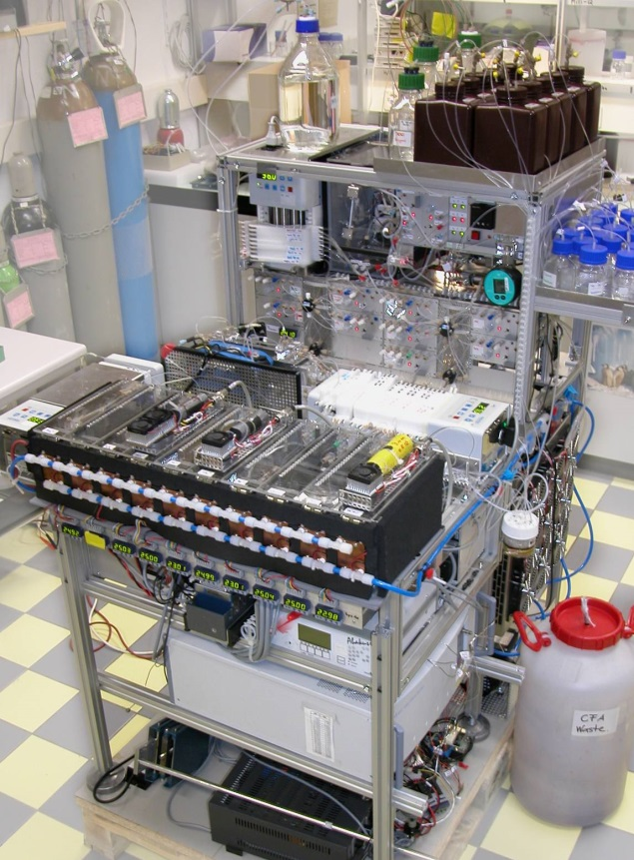
Bern CFA System
What do we do with the ice?
temperature reconstruction (stable water and nitrogen isotopes)
heat transport in ice sheets
marine, terrestrial, biogenic and extraterrestrial aerosol
biogeochemical cycles (greenhouse gases and isotopes)
mean ocean temperature (noble gases)
Ice cores, paleoclimate, biogeochemical cycles (contact: hfischer@climate.unibe.ch)

Slide 5
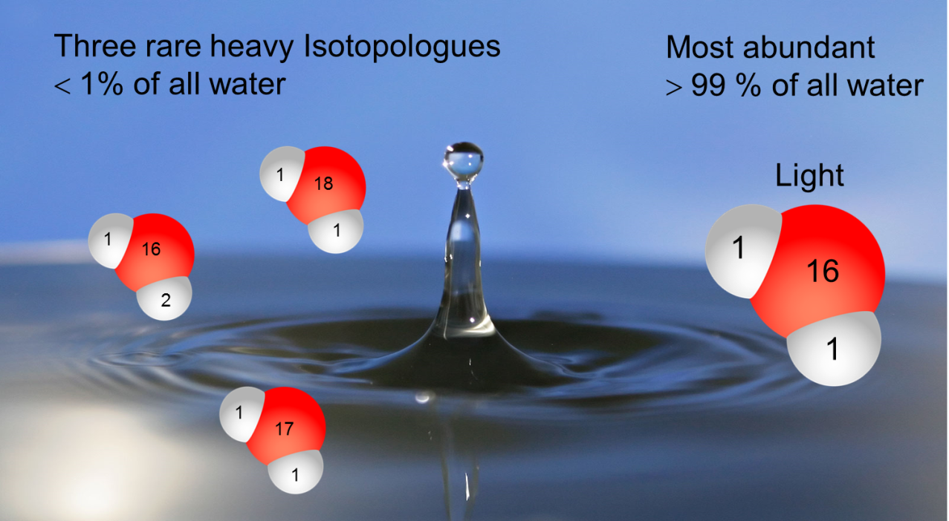
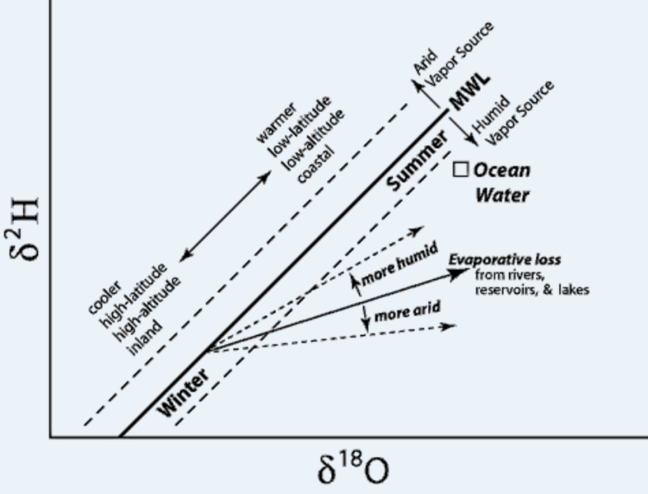
Isotopes in the hydrological cycle
Measurements of stable water isotopes help to understand the hydrological cycle
Evaporation, condensation, diffusion, adsorption, transpiration all change the isotopic composition
archives: stalagmites, ice cores, groundwater, precipitation
Env. archives, atmosphere, stable isotopes (contact: leuenberger@climate.unibe.ch)

Slide 6
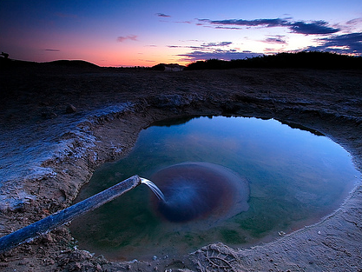
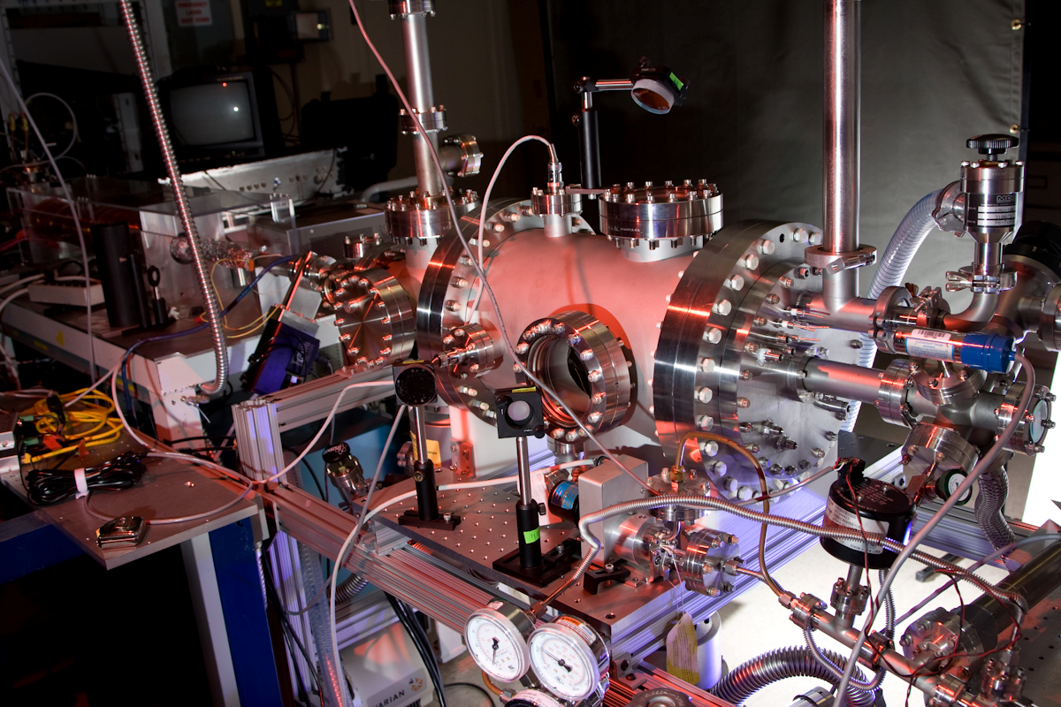
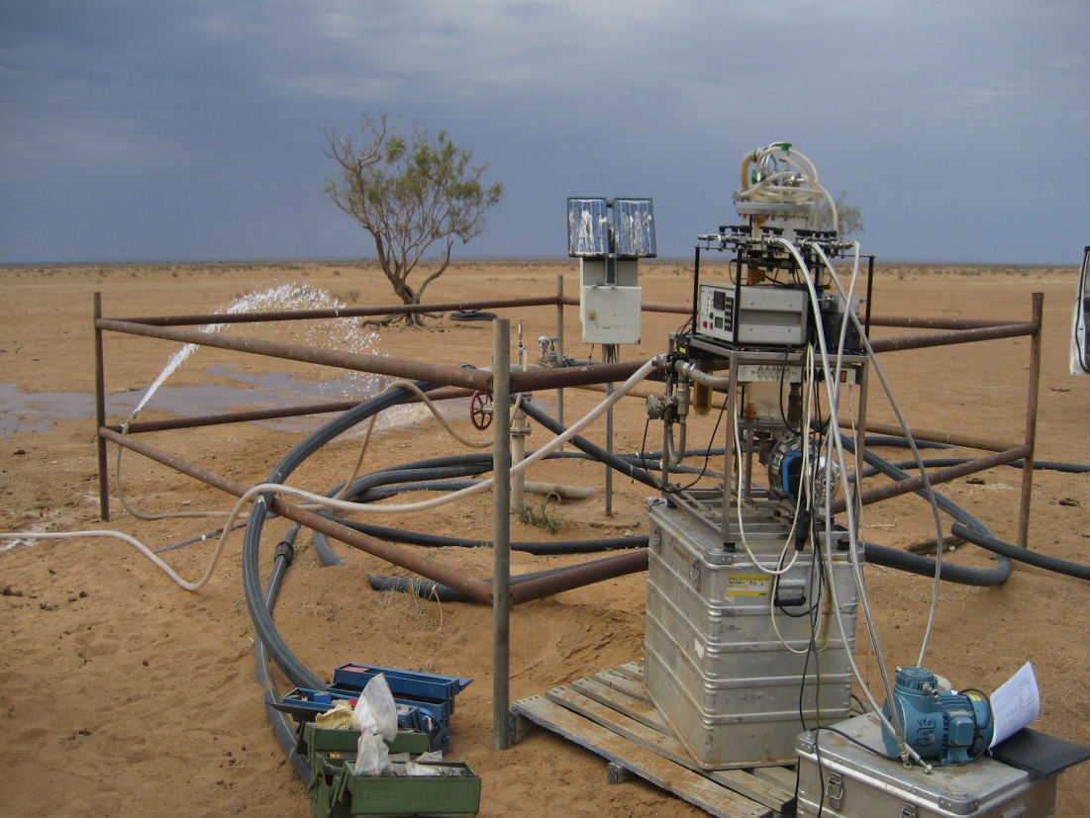
Isotope Hydrology
Characterisation of groundwater dynamics using isotopes
Influence of climate change on the hydrological cycle and groundwater recharge
Climate reconstruction using groundwater in middle latitudes
Cosmogenic nuclide production in the ground
Development of new technologies
Hydrology, radiometric dating (contact: purtschert@climate.unibe.ch)
Notes:
6
Thematik:
Beschreibung von Hydro- und Atmosphäre mittels Umwelttracern. Schwerpunkt Edelgasisotope

Slide 7
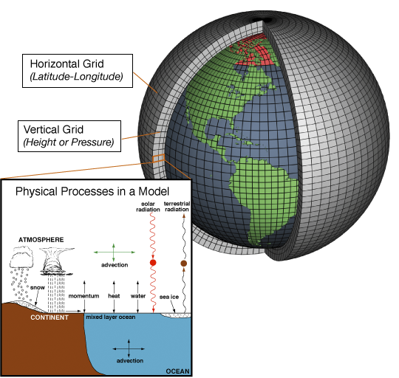
Modeling of the physical climate system
Modeling using the simplified Bern3D Earth System model
Ice age cycles
Probabilistic studies of the future climate
Modeling using the complex Earth System Model CESM
Climate variability of the last 1000 yr and the next 100 years
External forcing (solar, volcanos)
Modeling using the regional weather forecast model WRF
High-impact weather events (hurricanes, cyclones)
Atmospheric dynamics (contact: raible@climate.unibe.ch)

Slide 8
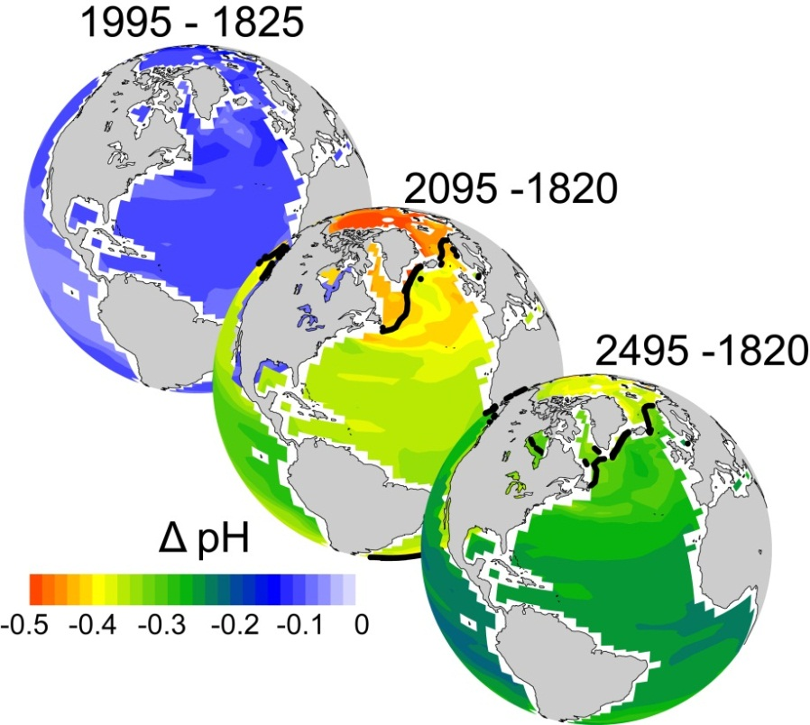
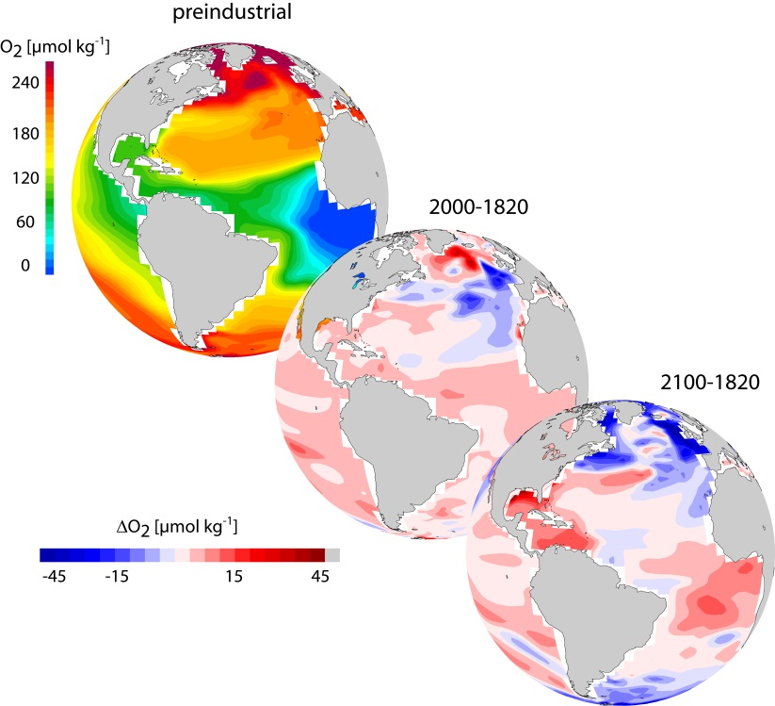
Earth System Models - tracer evolution in the land, ocean, and atmosphere
ΔpH
ΔO₂
"Earth System Models- Biogeochemical Cycles (contact: joos@climate.unibe.ch)
Themes: Implementierung eines Witterungsgenerators und
Analyse der Emissionen von Treibhausgasen aus der Biosphäre "

Slide 9
Besten Dank für Ihren Besuch!!
Danke für Ihre Aufmerksamkeit
Weitere Informationen auf:
http://www.climate.unibe.ch -> Jobs

